Slide 1
Last night in Razzmatazz, a drug story
Miguel Simón
Notes:
Hi everone, I'm going to present my project, which is about drugs. But first let me tell you a story

Slide 2
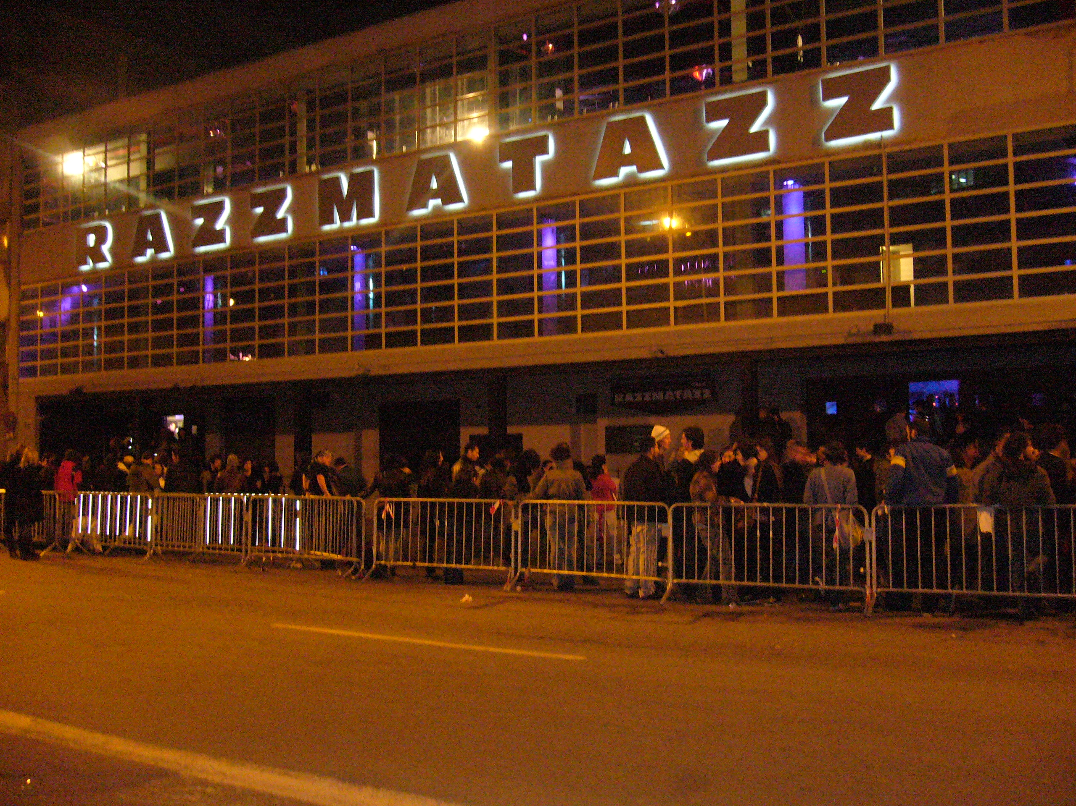
Notes:
I was one night dancing in razz and i though abut taking drugs

Slide 3
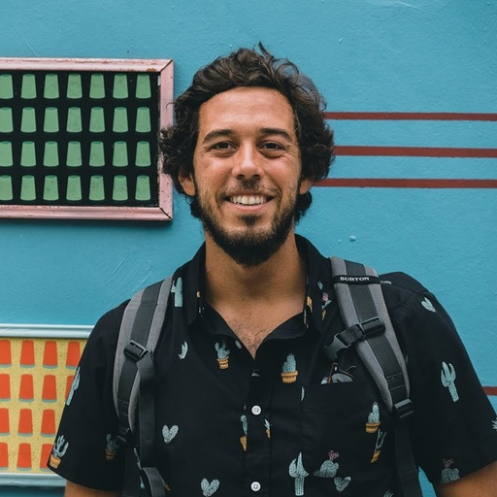
Notes:
luckily my friend andre was there. He had a lot of informmation about the topic because he is portugese

Slide 4
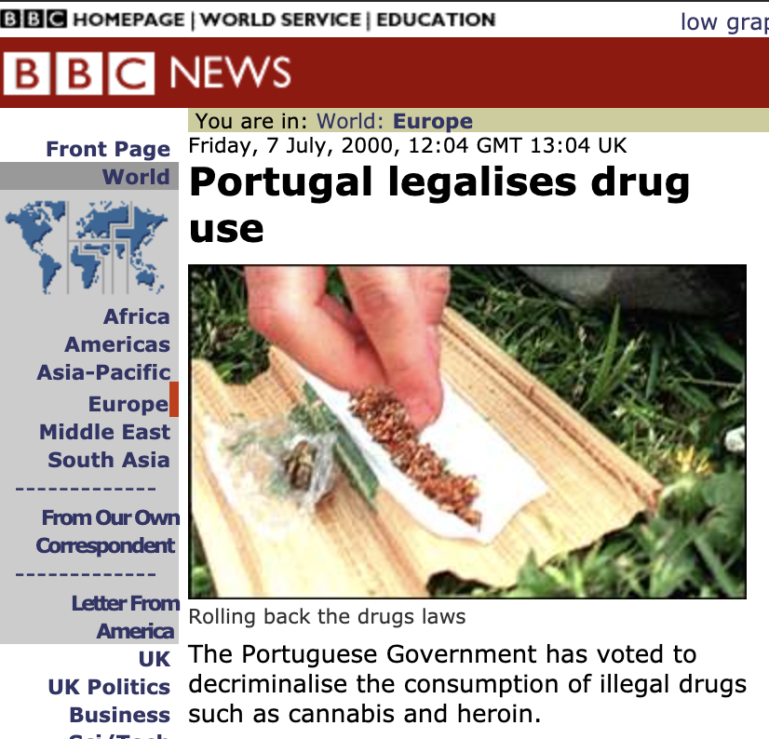
Notes:
And in portugal, the drug use was legalized almost 20 yers ago.
So, he decided to make me think about some drug-related topics.

Slide 5
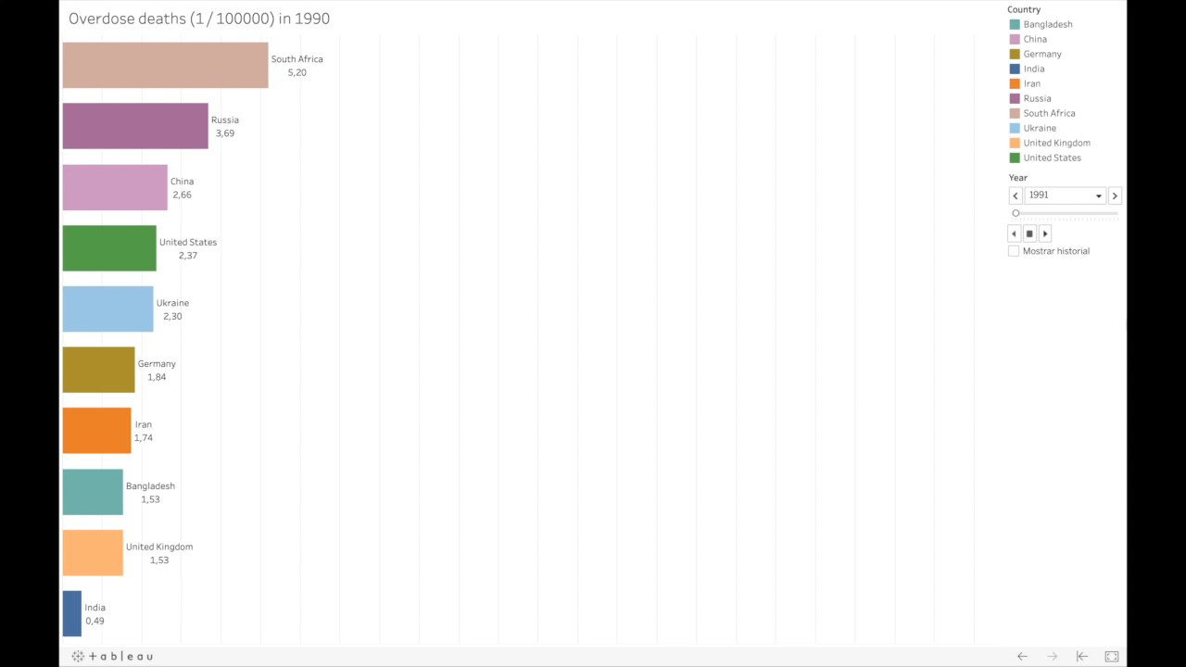
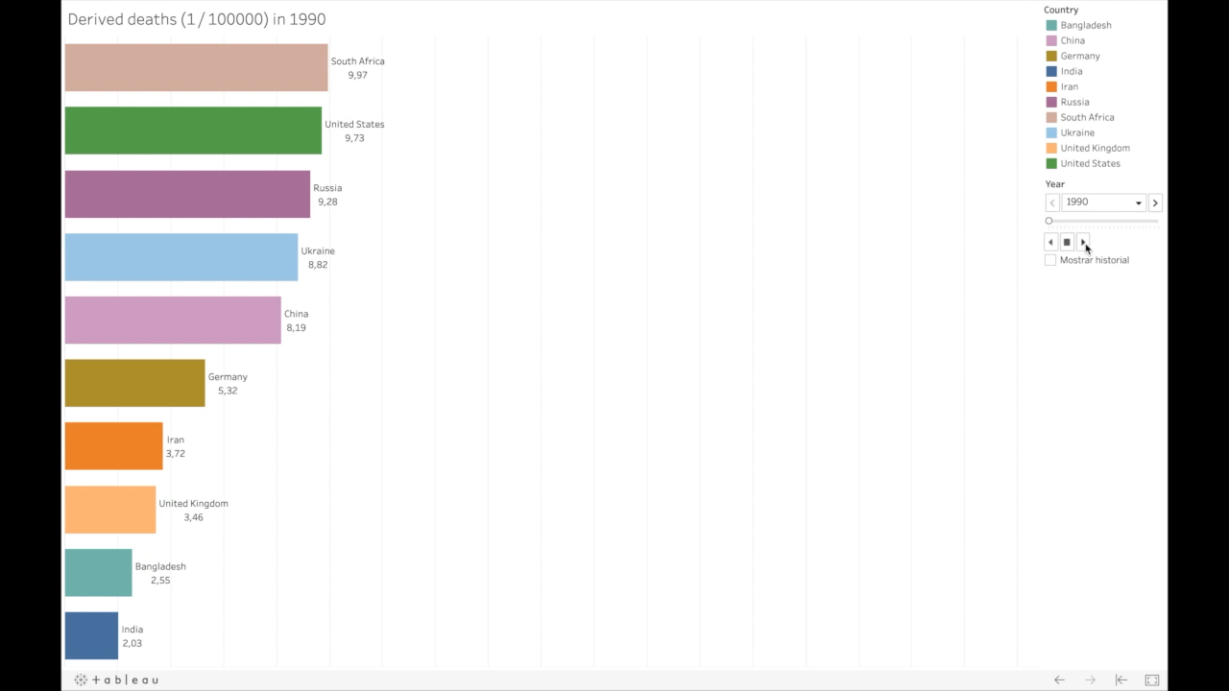
Will you suffer an overdose if you take drugs?
Notes:
For example, will I die from an overdose if i take drugs?
This is the top rate of deaths by overdoses in 1990, but we also need to take into account that many people who take drugs die not because of an overdose, but ebcause a problem derived from that, like depression or HIV infection.
I wanna show which was te evolution until 2017.
As you can see united states is the leader country in deaths by drug use.

Slide 6
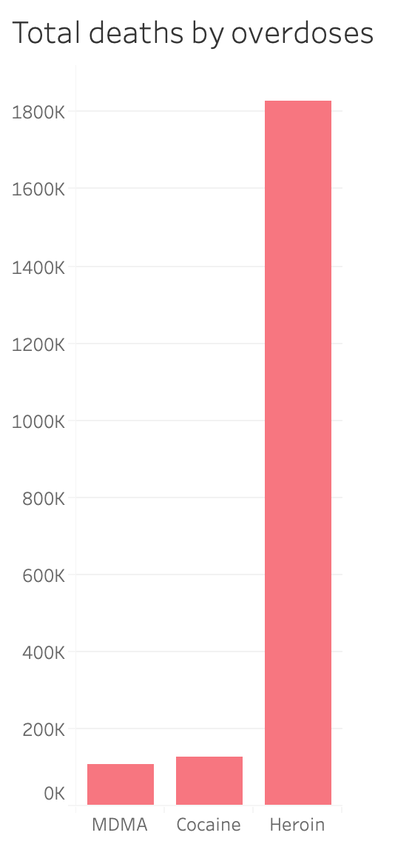
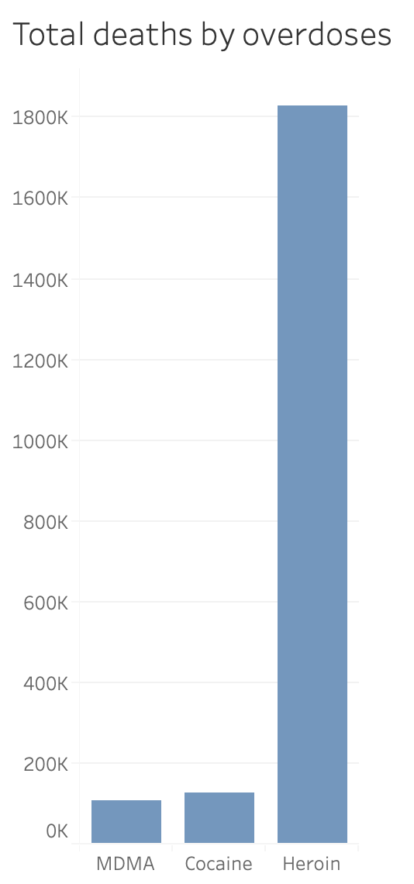
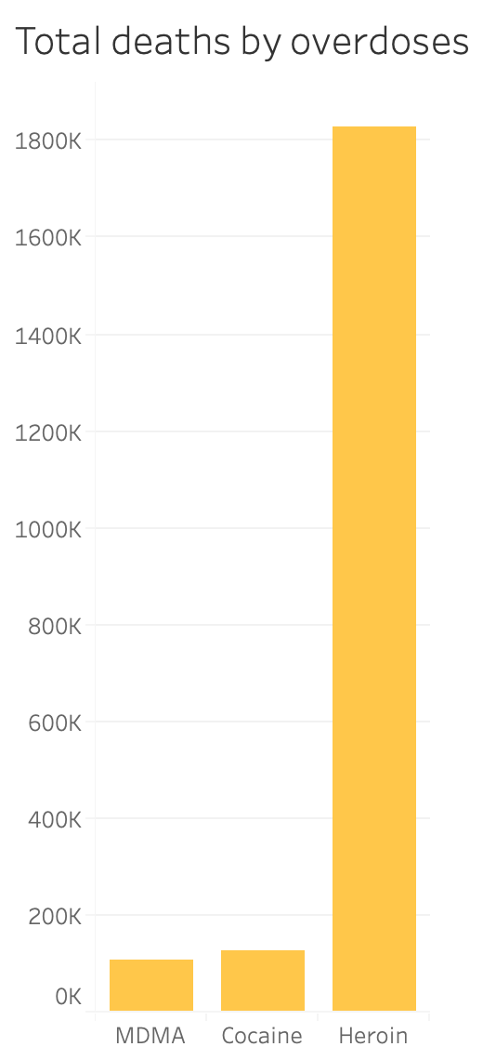
Will you suffer an overdose if you take drugs?
Notes:
It is important to say that, of course, heroin is more dangerous in terms of ovrdose than for example MDMA or cocaine.
But still, there are some countries that show high levels of overdoses from these two other drugs.

Slide 7
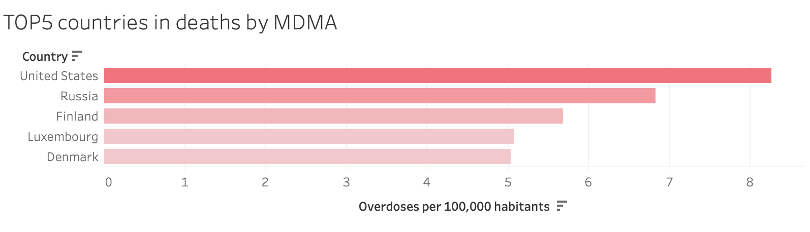
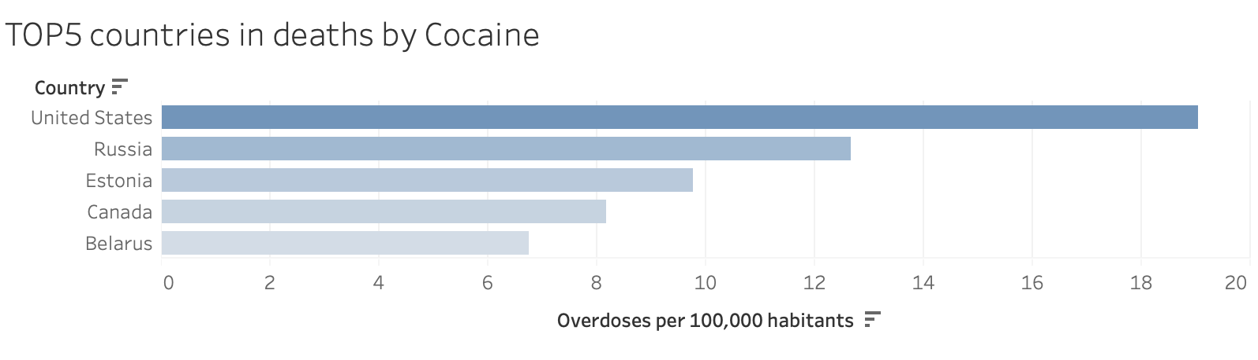
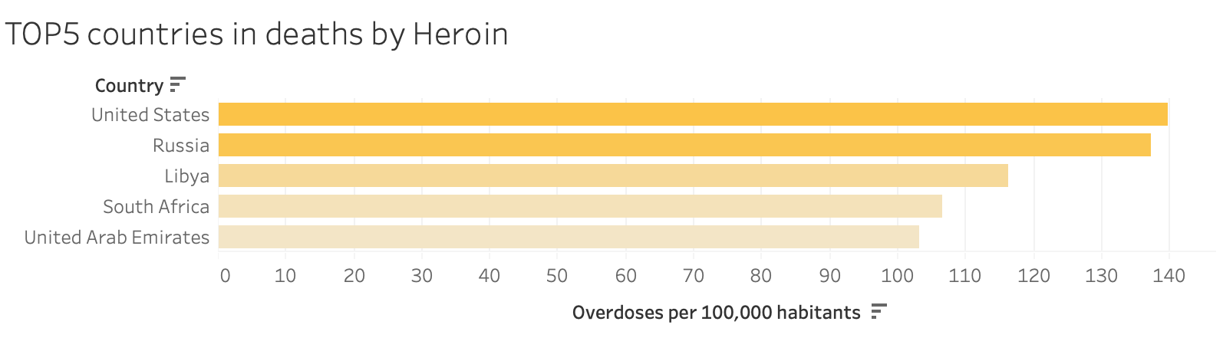
Will you suffer an overdose if you take drugs?
Notes:
Here, we can see that USA and Russia are the two top countries in deaths for all these 3 drugs.

Slide 8
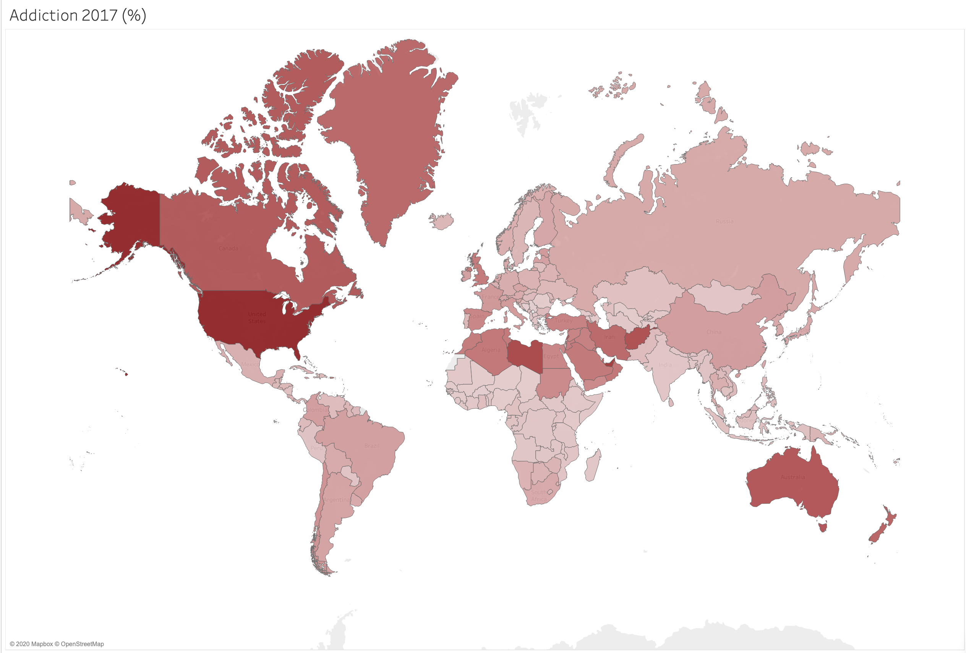
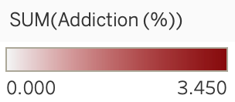
Will you become addicted if you take drugs?
Notes:
OK, maybe we dont die, but can we became addicted to drugs? This is the addiction map world. This map made me wonder if there is a correlation between the income level of the country and the addiction rate.

Slide 9
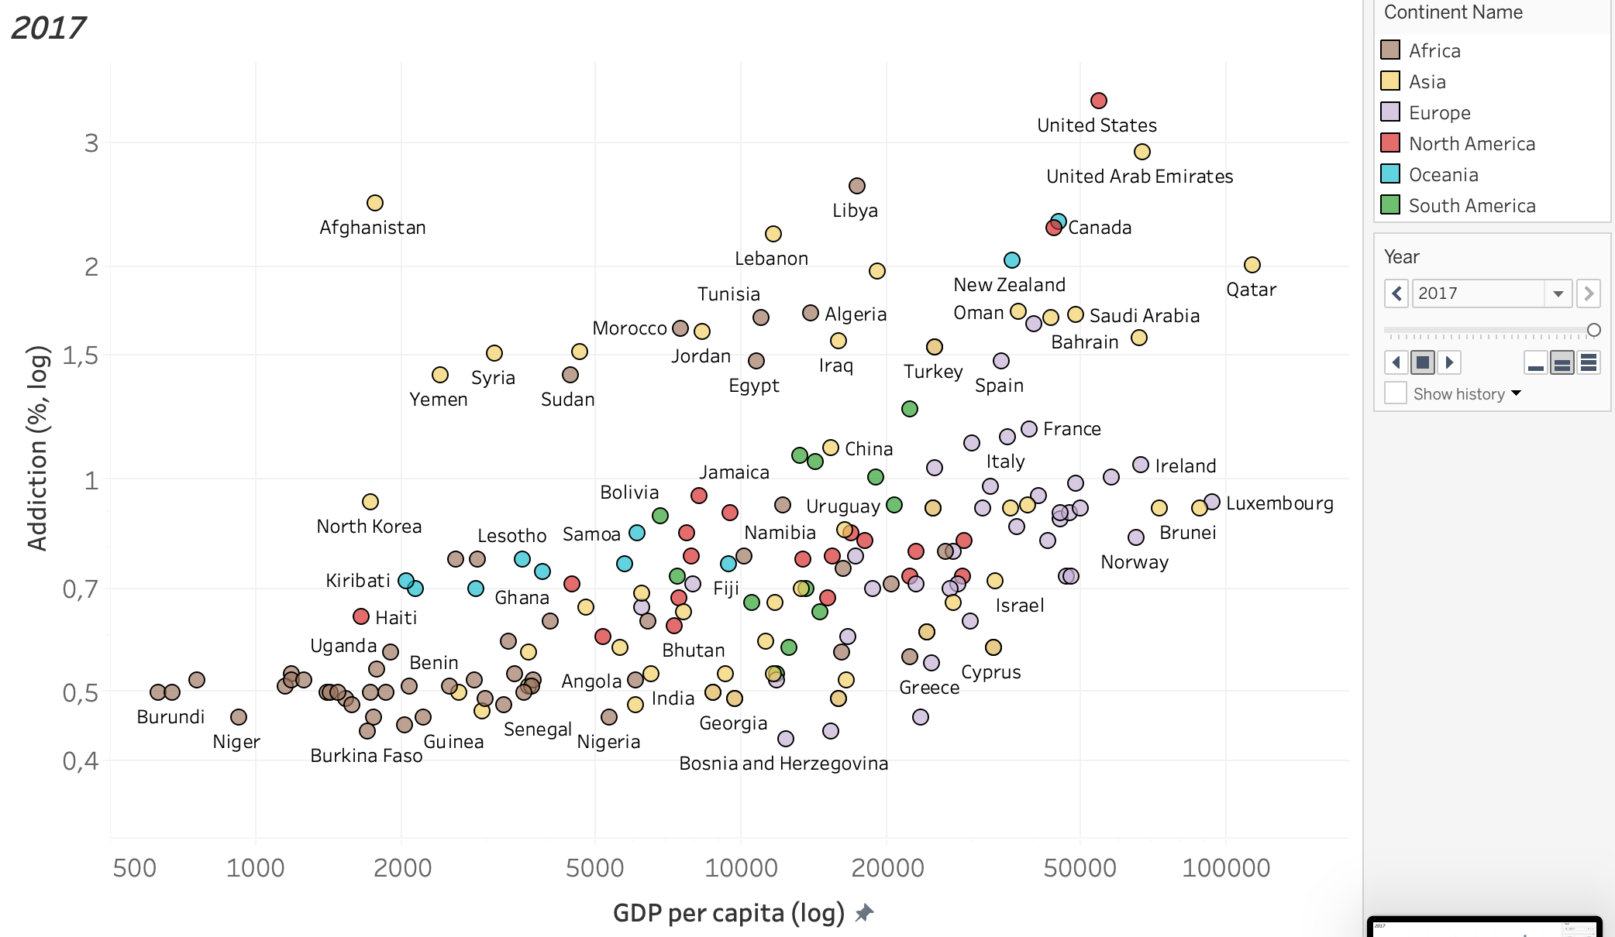
Will you become addicted if you take drugs?
Notes:
In this graph I'm relating the GDP per capita and the addiction rates per country. Colors indicate the continent of the country.
Now im going to change the size of the bubble depending on the deaths by drugs in that country.

Slide 10
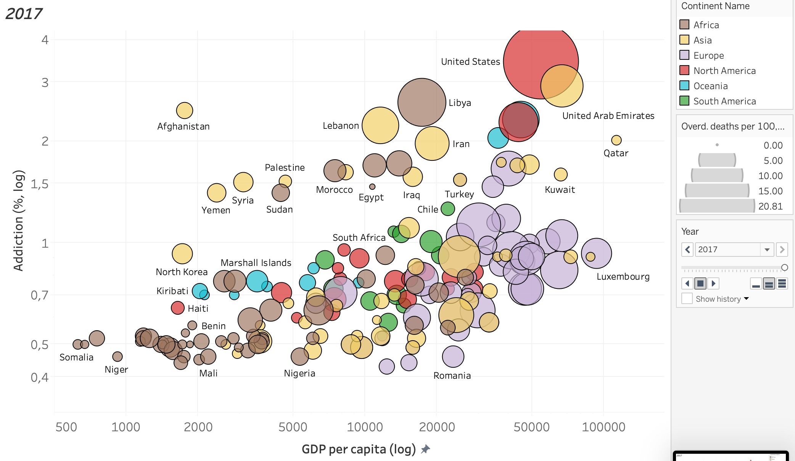
Will you become addicted if you take drugs?
Notes:
This is the final plot and...

Slide 11
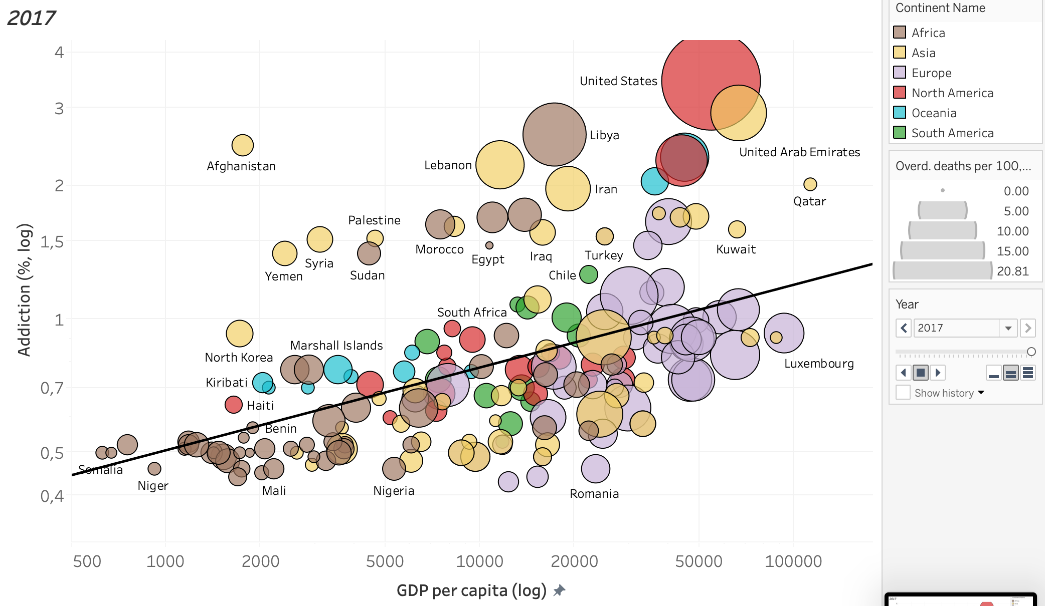
Will you become addicted if you take drugs?
Notes:
As we can see, there is a correlation between the wealth of the country and the level of addiction.

Slide 12
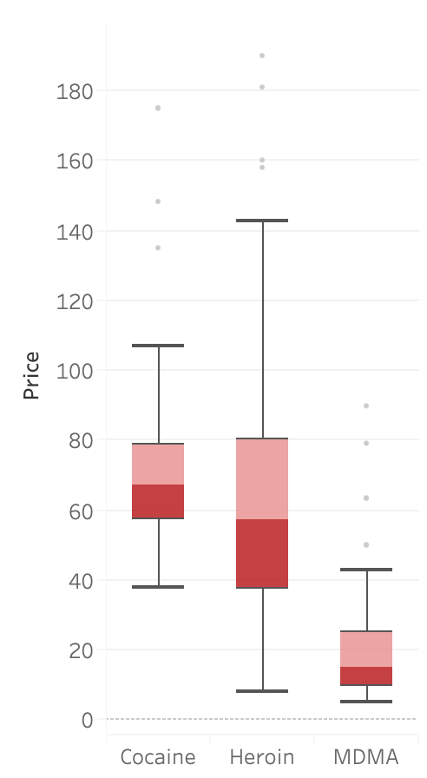
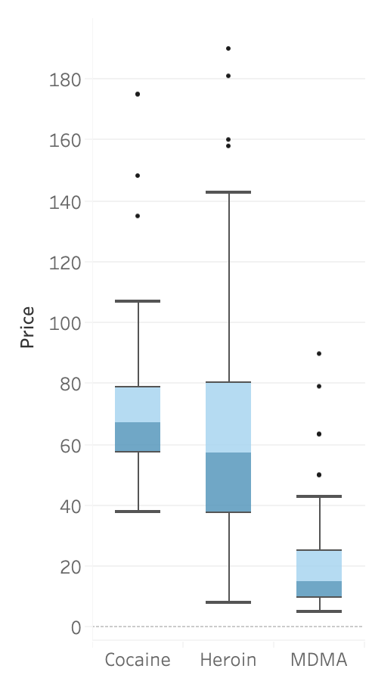
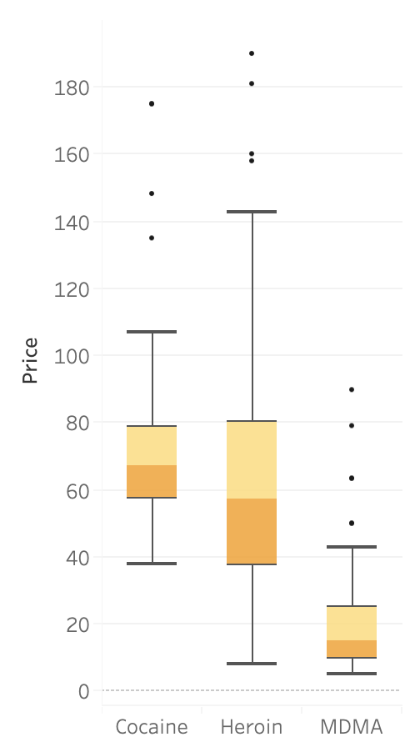
Which is the most expensive and pure drug?
Notes:
Annother interesting parameter is the price and te purity of the drug. As we can see MDMA tends to be the cheapest drug in this comparison.

Slide 13
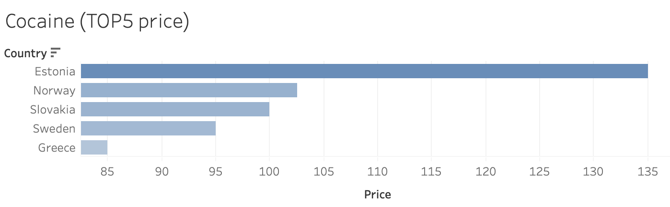
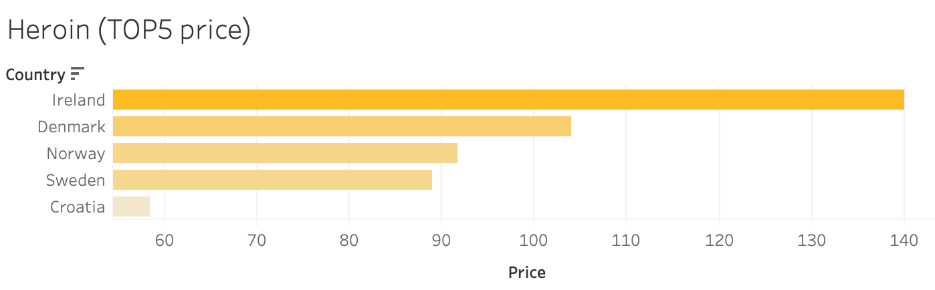
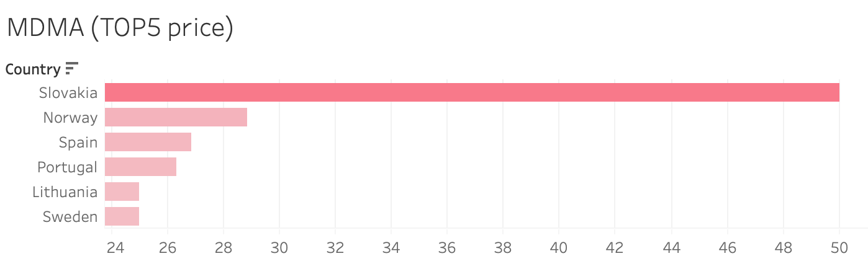
Which is the most expensive and pure drug?
Notes:
And it seems that the northern european countries have the higer prices.

Slide 14
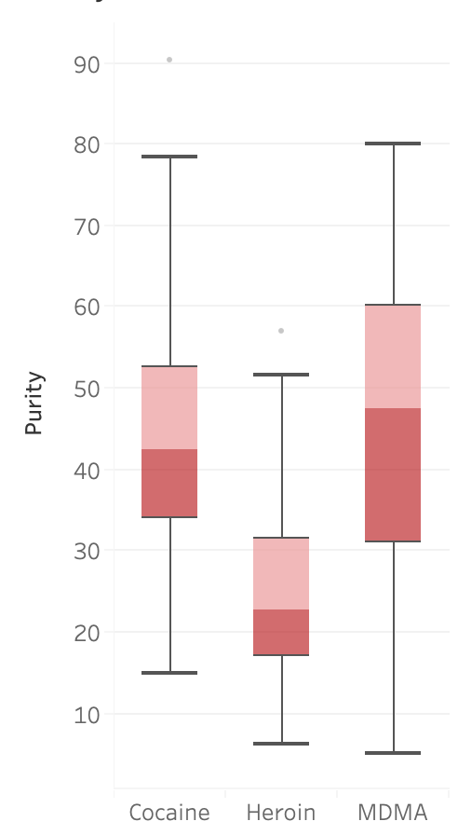
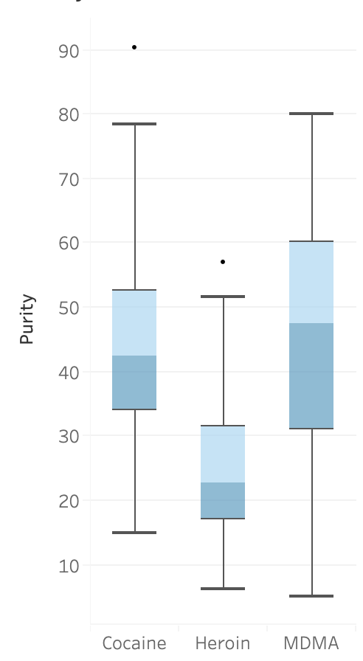
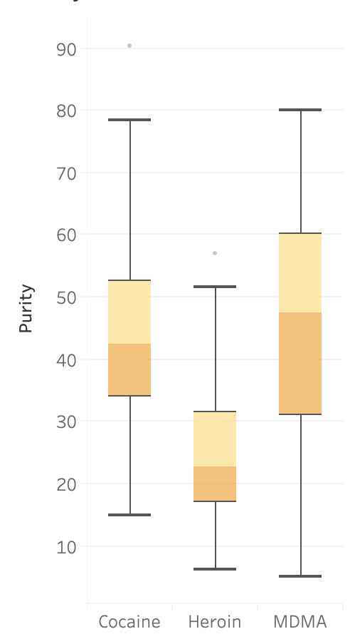
Which is the most expensive and pure drug?
Notes:
Abput purity, Heroin seems to be te less pure drug.

Slide 15
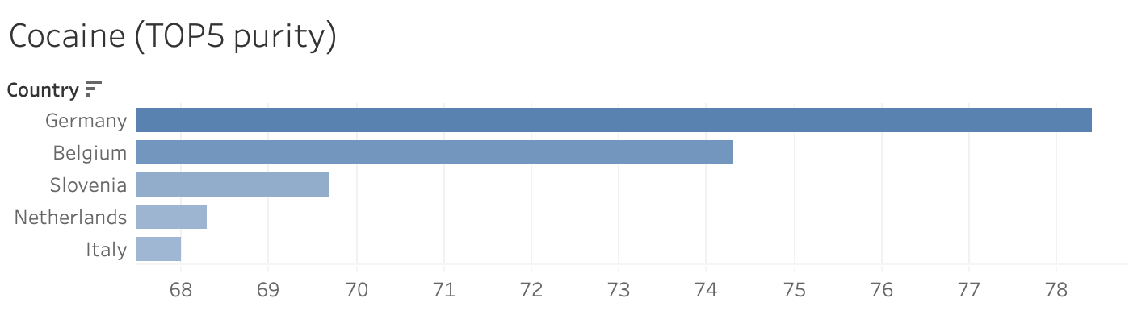
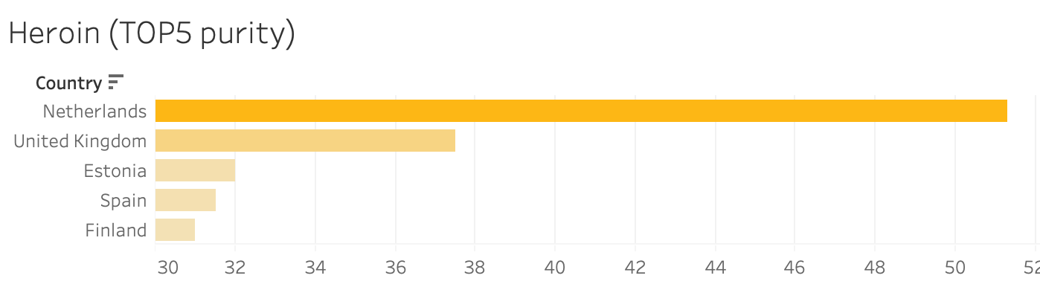
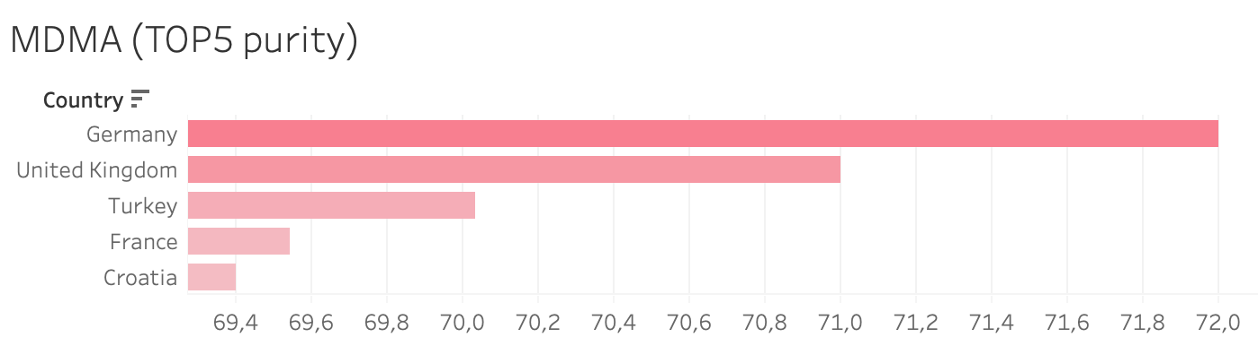
Which is the most expensive and pure drug?
Notes:
and the top countries in termsof purity seem to be germinay, UK and netherlands.

Slide 16
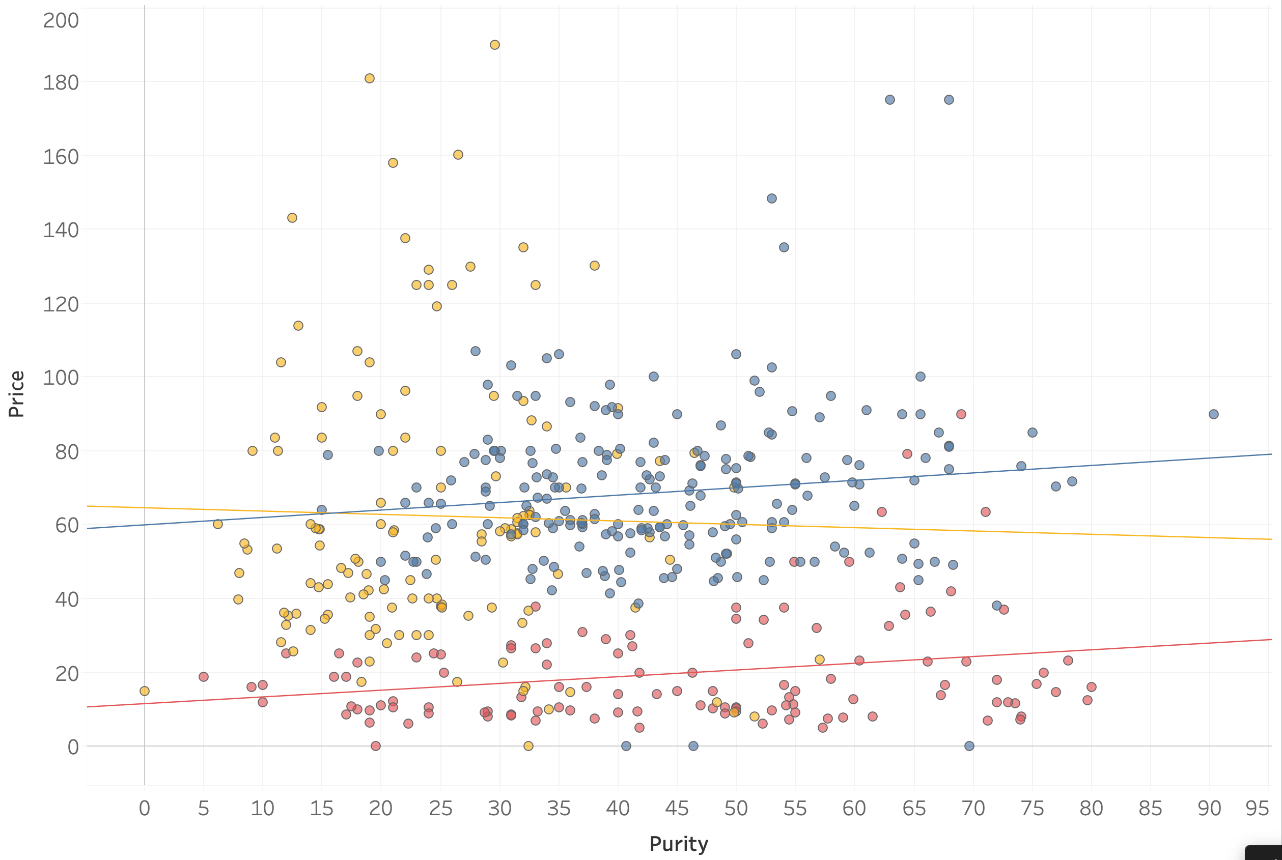
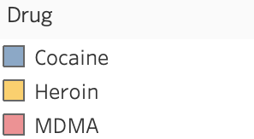
Which is the most expensive and pure drug?
Notes:
It is very curious that I was looking fo a correlation between drug price and purity nd i did not find any.

Slide 17
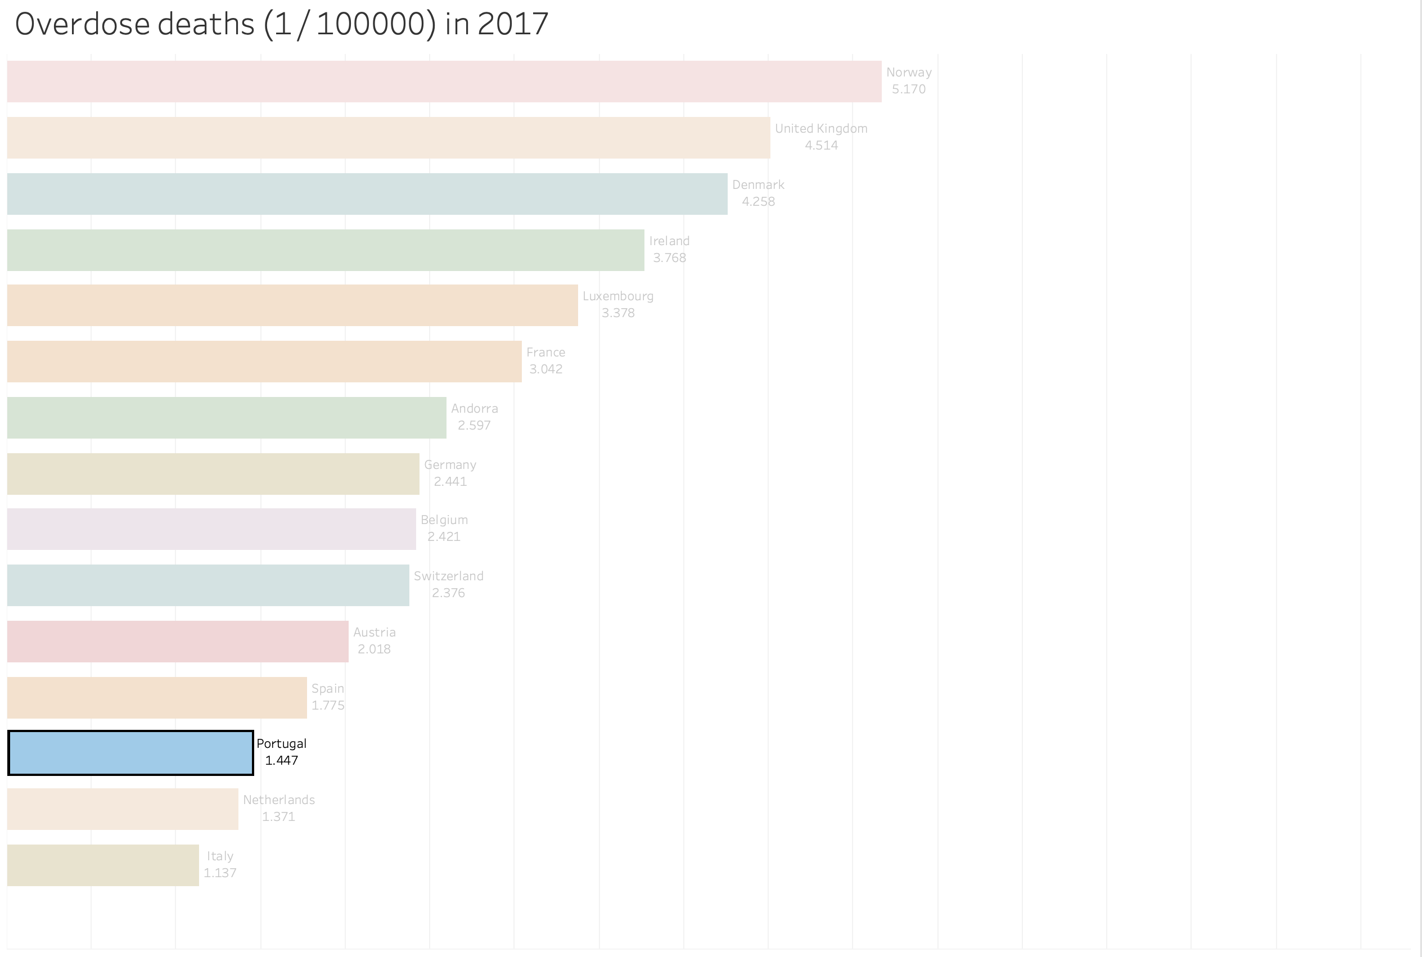
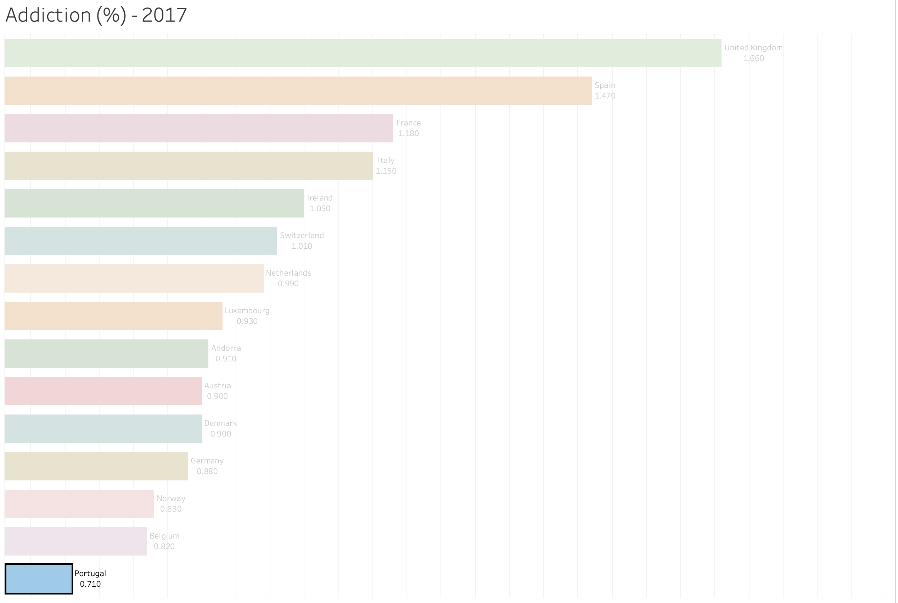
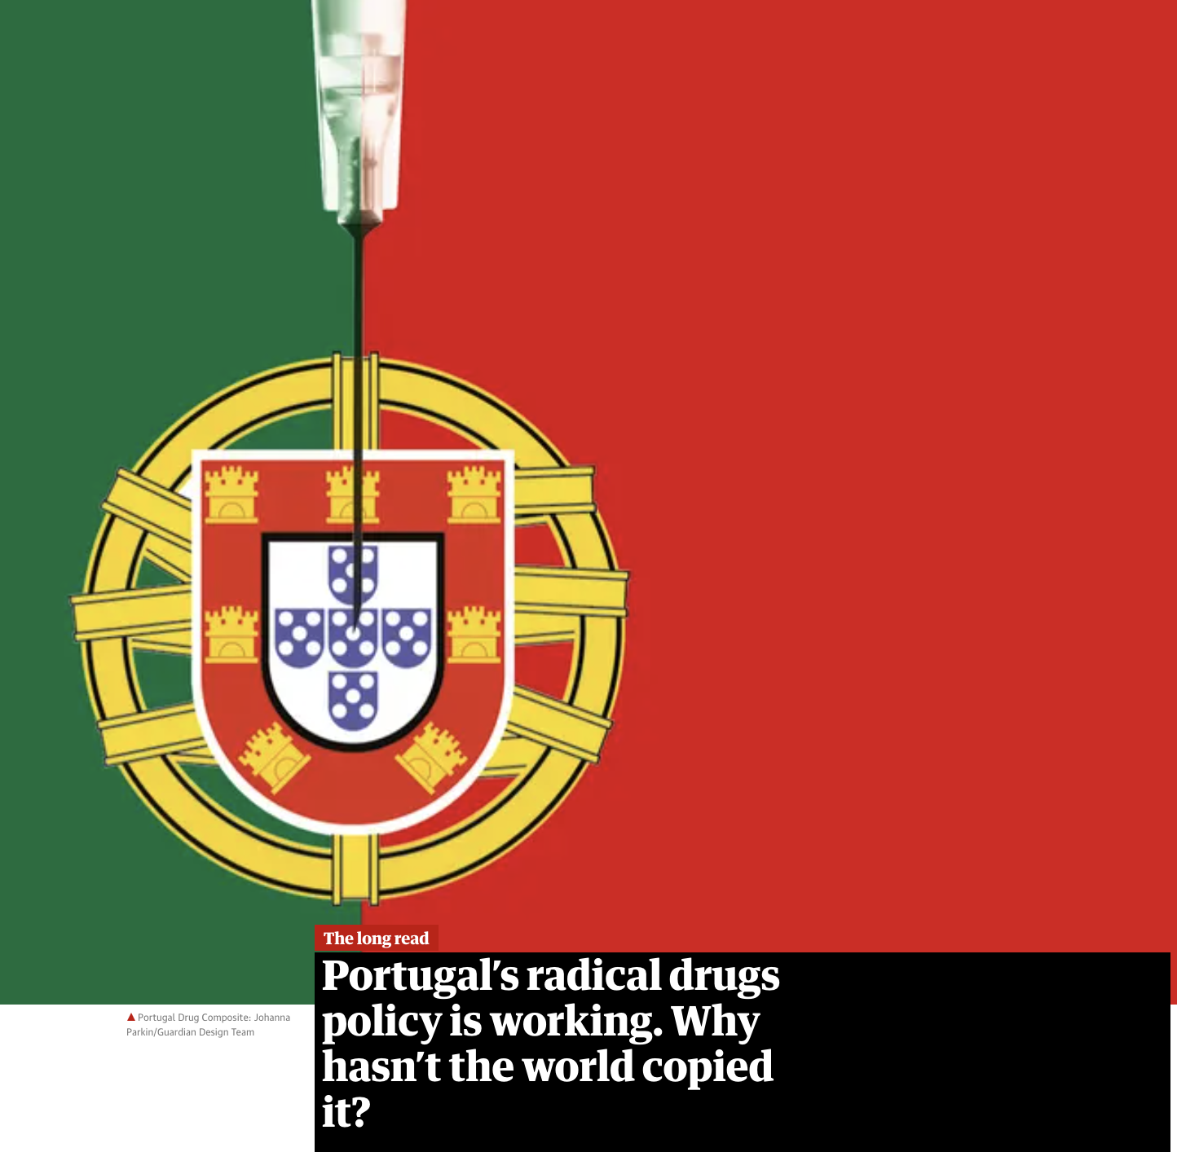
What about Portugal?
Notes:
But... what abput andré and portugal? well, it's good to say that portugal has one of the lowest overdosses deaths rates in western europe and also te lowest level of addiction.

Slide 18
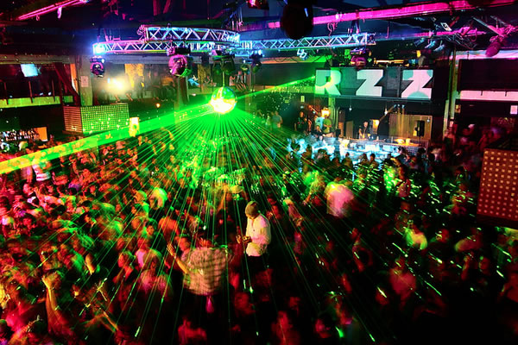
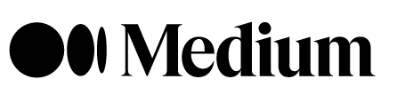
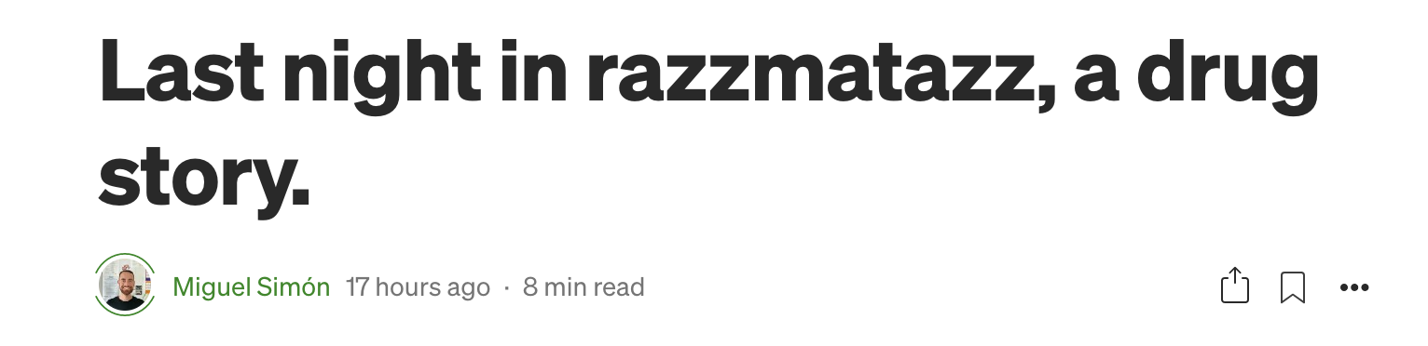
Notes:
So thats everything, if you wanna see the extended version of the project you can read the medium article.

Slide 19
Thanks for the attention
Notes:
So thats everything, if you wanna see the extended version of the project you can read the medium article.

